Slide 1
Inclusive Communication
Tina Yu
Policy Officer, Sense Scotland

Slide 2
Inclusive Communication Hub
Disability Equality Scotland
Sense Scotland
www.inclusivecommunication.scot

Slide 3
Definitions
Inclusive communication means sharing information in a way that everybody can understand.
People have communication support needs if they need support with understanding, expressing themselves or interacting with others.
Notes:
I wouldn’t keep this one here either but skip to the UN convention on the rights of children

Slide 4
Overarching Rights
There are some fundamental human rights that we all share, including communication rights
Everyone shall have the right to freedom of expression; this right shall include freedom to seek, receive and impart information and ideas of all kinds, regardless of frontiers, either orally, in writing or in print, in the form of art, or through any other media of his choice.
Article 19 of the Universal Declaration of Human Rights (United Nations, 1948)
Notes:
Paul – I would take this out for the panel discussion
JACKY…
We can see here that this is a very wide definition of ‘information’
Freedom of expression should not be confused with the right to say anything that you like. There are other laws around that!

Slide 5
Human Rights Act
Sets out the fundamental rights and freedoms that individuals in the UK have access to:
Article 10 sets out the right to information.
Notes:
Take out for the panel discussion

Slide 6
And – Equality Act 2010
The Act requires service providers to make reasonable adjustments for disabled people to avoid disadvantage and is clear that reasonable adjustment includes provision of information in an accessible format.
Notes:
Take out as a slide and just include in your brief summary of other legislation

Slide 7
What works well
When your communication support needs are met
How do we do this?
Notes:
I would take out

Slide 8
Making changes on inclusive communication
As an organisation
Individual
Notes:
I would take out but come back to later in summary saying changes will need to take place at both organisational and individual levels

Slide 9
Organisational change
Adopting good inclusive communication practice
Using Principles of Inclusive Communication :An information and self-assessment tool for public authorities
Incorporating these principles into Equality Impact Assessment (EQIA) or other tools
such as EQFM
Notes:
Take out

Slide 10
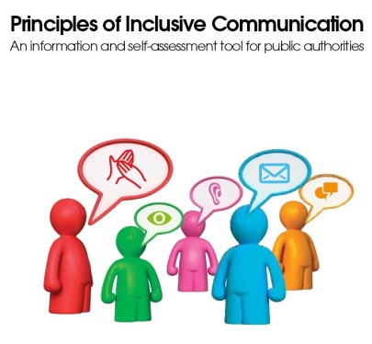
Principles of Inclusive Communication
Communication accessibility and physical accessibility are equally important
Every community or group will include people with different communication support needs
Communication is two-way process of understanding others and expressing yourself
Be flexible in the way your service is provided
Effective user involvement will include the participation of people with different communication support needs
Keep trying
Information and self-assessment tool for public
authorities (2011) – Scottish Government

Slide 11
Making information more accessible
Providing alternative formats
Adding Alt Text to images on social media and documents

Slide 12
Making individual changes
Notes:
Take out

Slide 13
Be a good communication partner
Get – get the persons attention before you say anything so that they know you are talking to them
Different – use different methods of communication if needed, pictures, drawings, maps, writing things down can all help.
Ask – if you think someone may need support then ask.
Repeat – its Ok to ask the person to repeat what they have said.
Check Understanding – check you have
understood and the person has understood
Keep trying!

Slide 14
Working with black and minority ethnic (BAME) communities
Not a homogenous group
Intersectionality
Language and culture may vary depending on demographics
Community engagement
Diverse workforce and peer support

Slide 15
Resources
www.inclusivesivecommunication.scot
SAIF: News - Scottish Accessible Information Forum Scottish Accessible Information Service (SAIF) (saifscotland.org.uk)
Principles of Inclusive Communication: An information and self-assessment tool for public authorities - gov.scot (www.gov.scot)
Publications – Interfaith Scotland
Anti-Racism - Resources and Support – CILIPS

Slide 16
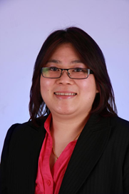
How to contact me
Tina Yu
Email: tyu@sensescotland.org.uk
Notes:
Maybe just say that you will be around for the day and people can ask for your contact details?

