Slide 1
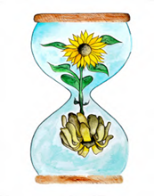
Learning about Bereavement, Loss and Grief
Lesson resource for P2
Learn
East Renfrewshire Bereavement, Loss and Grief Team
With thanks to Winston’s Wish

Slide 2
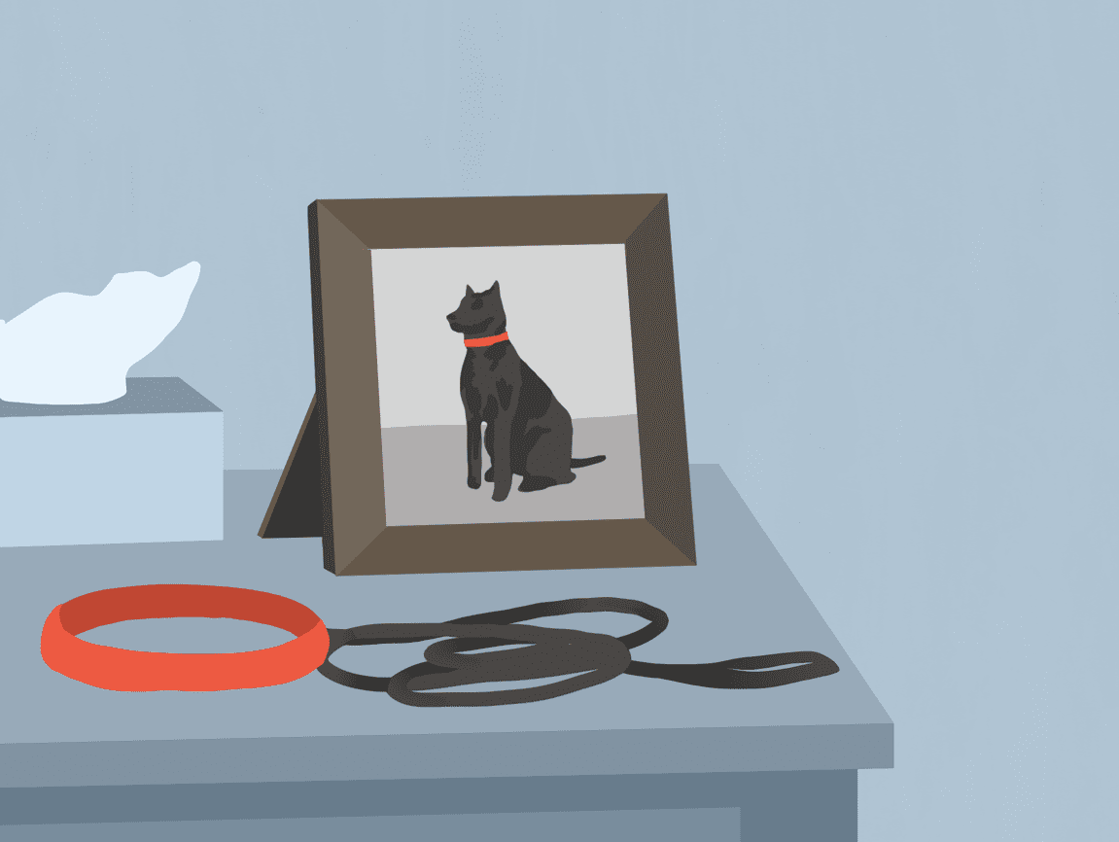
Today’s lesson
Today we will be thinking about loss and the death of pets
Some of us may have already experienced the death of a pet

Slide 3
This is how I’m feeling…
Begin by talking about your feelings. Let’s sing a song.
Notes:
https://www.fischytunes.com/video-repo/this-is-how-i-m-feeling/

Slide 4
How can we help everyone to feel safe and valued in this lesson?

Slide 5
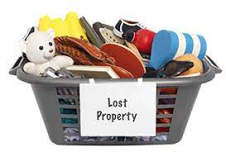
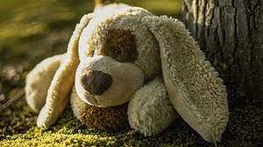
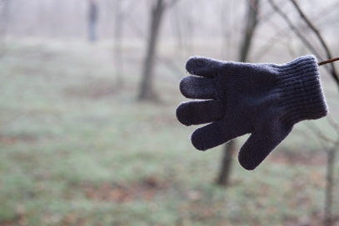
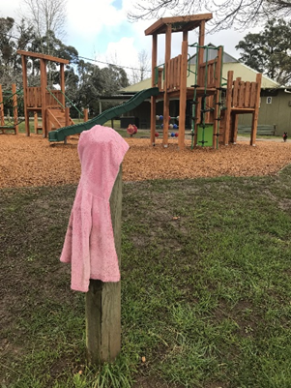
Loss
Can you think of things you have lost?
How did it make you feel?
What did you do?
Did you find it again?
Who helped you?

Slide 6
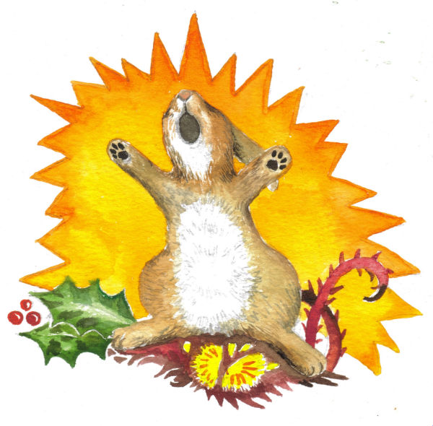
Saying Goodbye to Hare
The story includes the death of a hare.
A young rabbit witness the life, illness and death of his friend.
You should talk about the feelings and questions you have been reading this book.
Notes:
https://www.youtube.com/watch?v=5zp_oyBqi_0

Slide 7
Saying Goodbye to Hare
When someone dies their special spark of life lives on in our hearts. This is because we have special memories of the person.
Do you have special memories of a person or animal?

Slide 8
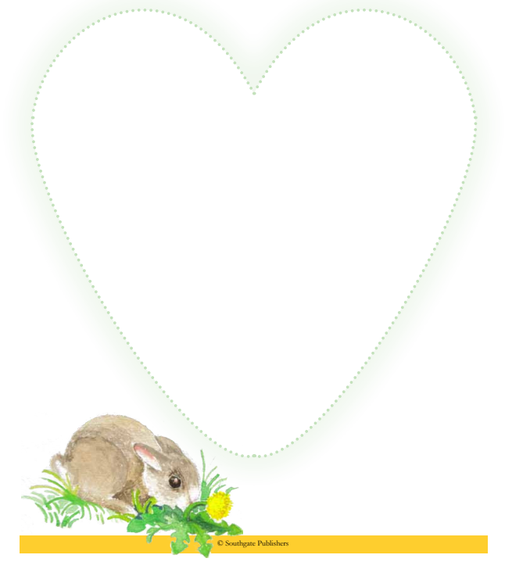
A Big Heart
Fill this BIG heart with pictures or writing of some of the memories you have.

Slide 9
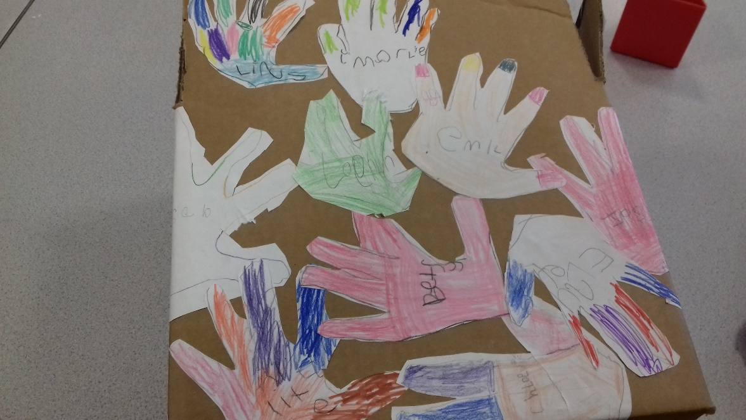
A Class Memory Box
Hare and Rabbit made a memory box together. As a class, make your own memory box. How would you decorate and design your box? You could base your design on a shoe box. Keep this in the class or take them home

Slide 10
What did we learn today?
Death is part of life.
I have found out that death means…
How can you remember someone?
I can remember…

Slide 11
Watch your worries float away
Play this game to let your worries go.
https://www.childline.org.uk/toolbox/games/balloon/
If you feel you can’t let your worries go, you should talk to a teacher!

Slide 12
Learning about Bereavement, Loss and Grief
Lesson resource for P2
Explore
East Renfrewshire Bereavement, Loss and Grief Team
With thanks to Winston’s Wish

Slide 13
Today’s lesson
Today we will be thinking about loss and the death of pets
Some of us may have already experienced the death of a pet

Slide 14
This is how I’m feeling…
Begin by talking about your feelings. Let’s sing a song.
Notes:
https://www.fischytunes.com/video-repo/this-is-how-i-m-feeling/

Slide 15
Recap - How can we help everyone to feel safe and valued in this lesson?

Slide 16
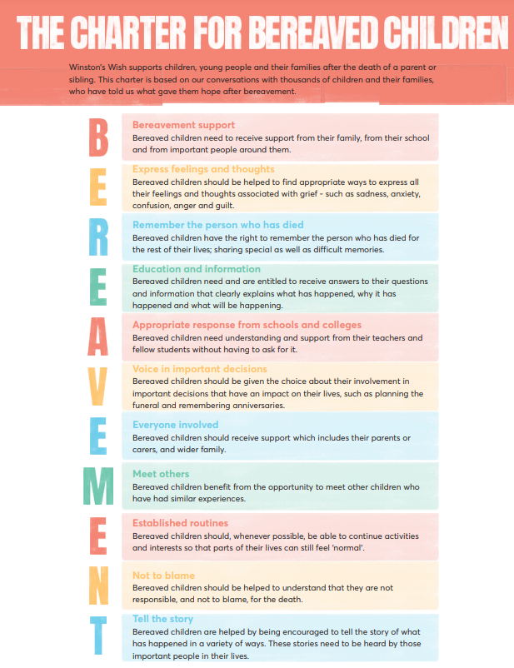
The Bereavement Charter

Slide 17
Recap from session 1 What happened in the story? What are memories? Share with other people in the class your special memories.

Slide 18
Changes in your life
Buzzard explains to Rabbit how life moves on and changes using the cycle of life in the woodland seasons. Explore the cycle of life in the woodland seasons by watching this clip.
Notes:
https://www.youtube.com/watch?v=zdKYWiVy9FY

Slide 19
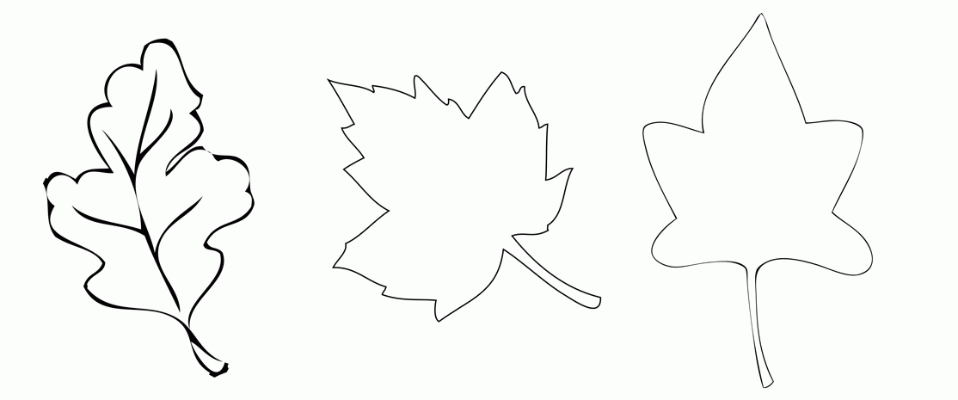
Changes in your life
Life changes forever when someone we love dies. If a very close family member dies, especially a parent, day-to-day life will never be the same again.
How has your life changed? Create a timeline of your life by drawing changes (big and small) on leaves.

Slide 20
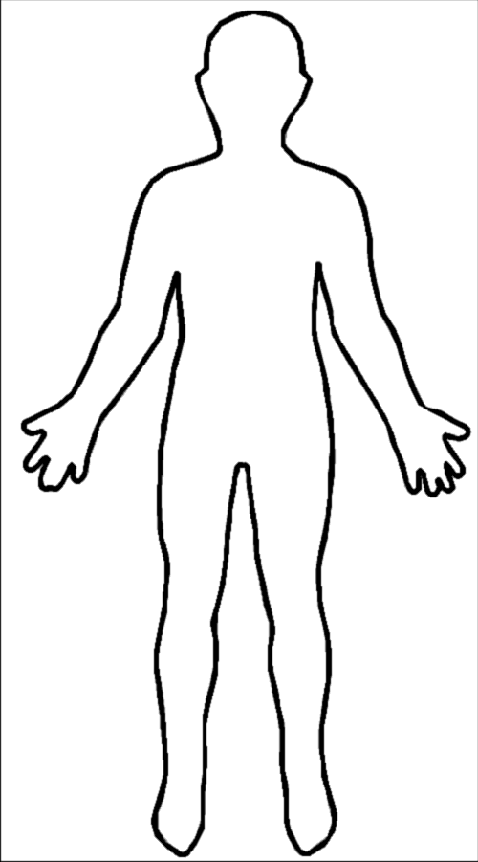
Changes in your life
When life changes, we may have strong feelings. Rabbit’s tummy hurt when he felt worried. On the outline, draw or write all your different worries and where you feel them in your body. Think about what they look like and what colours they are.

Slide 21
What did we learn today?
Life can change forever.
I have found out that changes in my life may include…
How might you feel when change happens?
I might feel…

Slide 22
Watch your worries float away
Play this game to let your worries go.
https://www.childline.org.uk/toolbox/games/balloon/
If you feel you can’t let your worries go, you should talk to a teacher!

Slide 23
Learning about Bereavement, Loss and Grief
Lesson resource for P2
Grow
East Renfrewshire Bereavement, Loss and Grief Team
With thanks to Winston’s Wish

Slide 24
Today’s lesson
Today we will be thinking what we can do to help ourselves and others when we feel sad

Slide 25
This is how I’m feeling…
Begin by talking about your feelings. Let’s sing a song.
Notes:
https://www.fischytunes.com/video-repo/this-is-how-i-m-feeling/

Slide 26
Recap - How can we help everyone to feel safe and valued in this lesson?

Slide 27
The Bereavement Charter
Remind yourself of the bereavement charter and your own class charter for loss, grief and bereavement.

Slide 28
Recap from session 1 and 2 What happened in the story? What are memories? What is change? How might our lives change? How many emotions can you think of? How does your body feel when you express these?

Slide 29
A Stormy Day

Slide 30
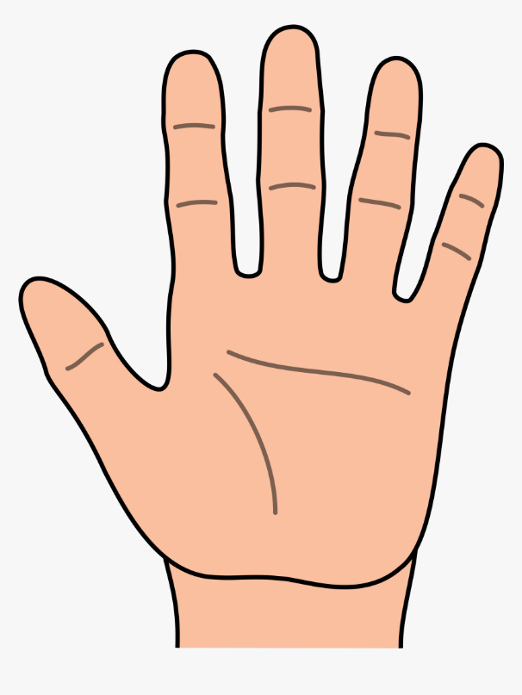
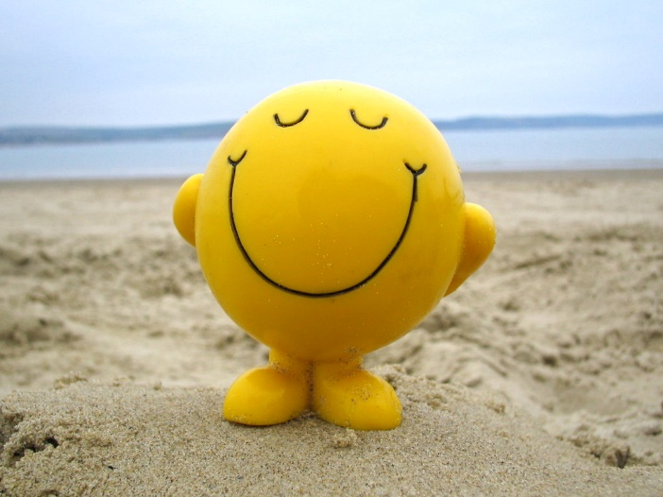
Sadness doesn’t last forever!
Can you think of 5 things that make you happy?
Make a picture of something that makes you happy

