Slide 1
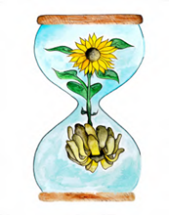
Learning about Bereavement, Loss and Grief
Lesson resource for P1
Learn
East Renfrewshire Bereavement, Loss and Grief Team
With thanks to Winston’s Wish

Slide 2
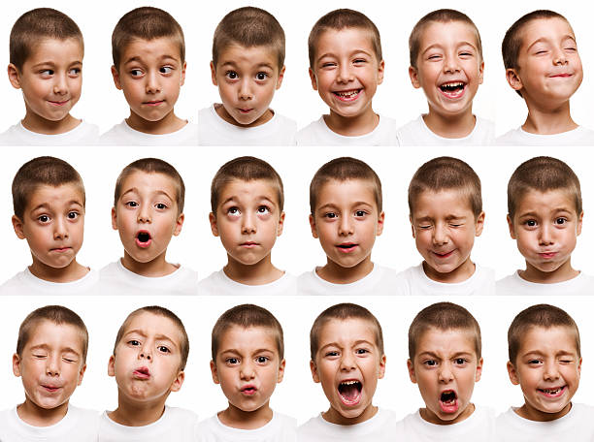
Today’s lesson
Today we will be thinking about emotions

Slide 3
How can we help everyone to feel safe and valued in this lesson?

Slide 4
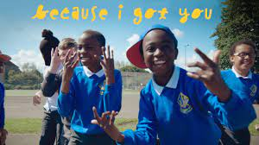
Let’s feel good and celebrate our friends!
Our friends can make us feel really good!
Notes:
https://www.fischytunes.com/video-repo/because-i-got-you/

Slide 5
We all feel lots of emotions
How do you think the boy is feeling? What makes you feel different emotions?

Slide 6
The Paper Dolls
Notes:
https://www.youtube.com/watch?v=IbBQ4lqXT8I
https://www.youtube.com/watch?v=Q3bbTuCPjKI

Slide 7
The Paper Dolls
How does the little girl feel when her dolls get cut up?
Have you ever felt sad? What happened? Who or what helped you?
Where do the paper dolls go?
Can you remember what else was there?
A kind granny is there too. Can you think why her granny was in her memory?

Slide 8
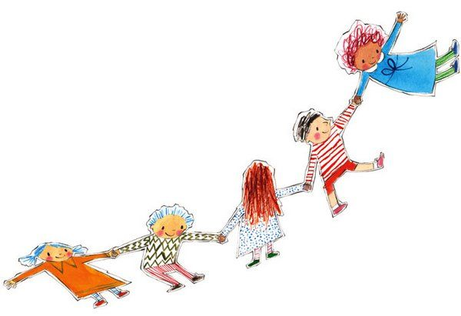
Make Your Own Paper Dolls!
Create your own paper dolls of people in your family or people you are close to.
Some people may not be with us any more. They might have moved away or they might have died.
We can still remember them and this will help us when we feel sad.

Slide 9
What did we learn today?
We all feel lots of emotions
Sadness is an emotion.
I feel sad when…
Loss is a part of life.
I felt sad when I lost...

Slide 10
Feeling Happy
When you feel sad, do something that makes you happy.
If you feel sad, it can help to talk to someone!
Tell us your best joke!
Notes:
https://www.youtube.com/watch?v=cK1LdvpglsE

Slide 11
Learning about Bereavement, Loss and Grief
Lesson resource for P1
Explore
East Renfrewshire Bereavement, Loss and Grief Team
With thanks to Winston’s Wish

Slide 12
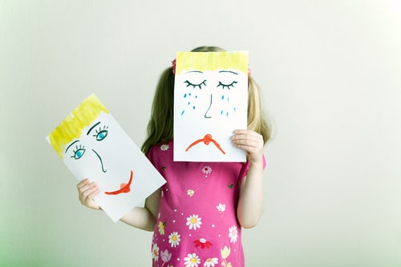
Today’s lesson
Today we will be thinking about change.
Some of us may have already experienced lots of change in our lives.

Slide 13
Recap - How can we help everyone to feel safe and valued in this lesson?

Slide 14
The Paper Dolls What happened in the story? How did this make you feel? It is sad when we lose something close to us or when someone dies.

Slide 15
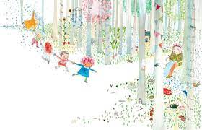
At the end of the book the paper dolls go somewhere very special into the little girl's memory.
Remembering good things can help us when we feel sad when someone or something is gone.
​
What special memories do you have?

Slide 16
Ageing, death and dying
What changes as you grow and get older?
Do you look different?
Do you talk differently?
What things can you not do as a baby that you can do when you are a bit older?

Slide 17
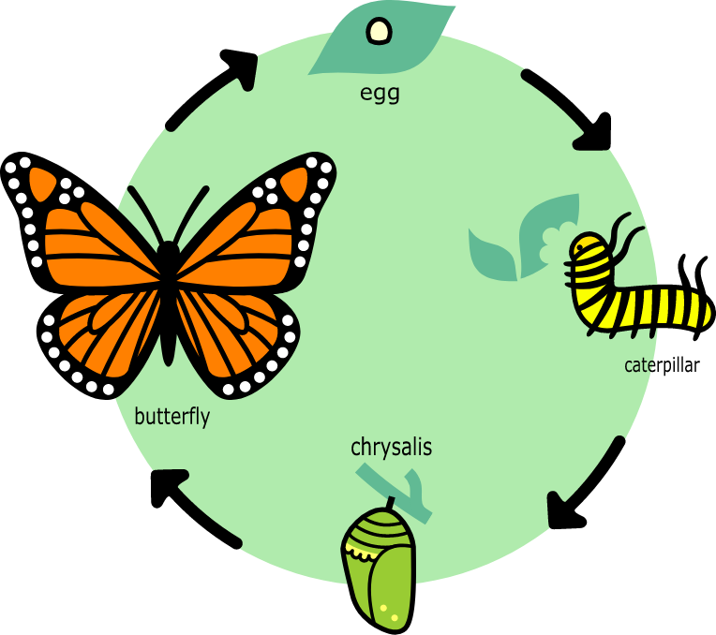
Change
All things that are alive have a beginning and an end and will go through a series of changes
Let’s look at the lifecycle of a butterfly
Notes:
https://www.youtube.com/watch?v=O1S8WzwLPlM

Slide 18
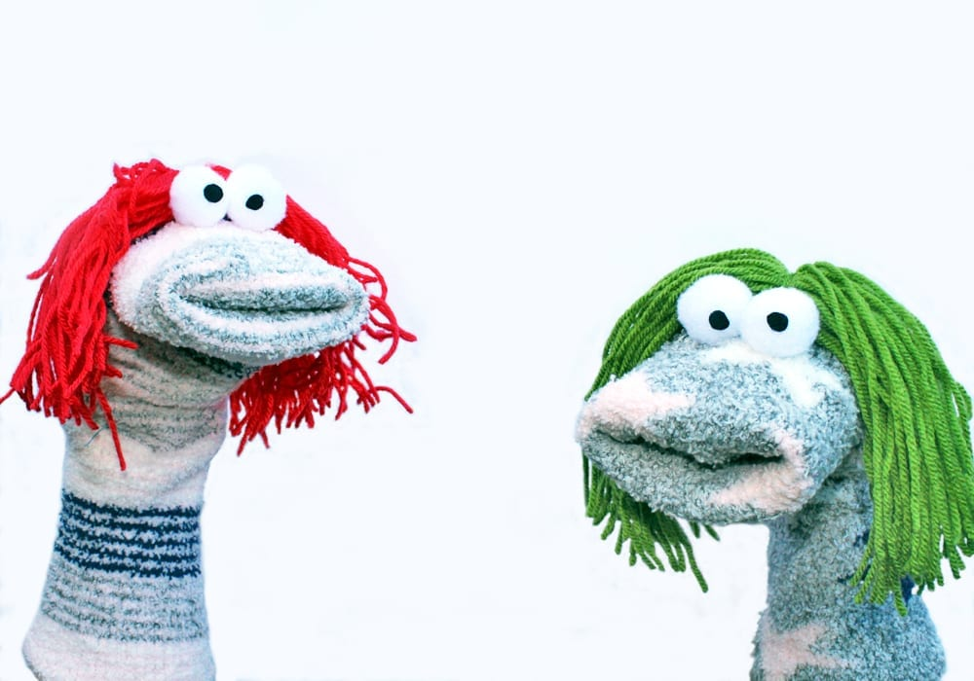
Change
Think about things that can change for us.
Act out a scenario with the class where something has changed for your chosen character.
How do the characters feel? What might help them feel better?

Slide 19
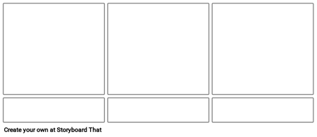
Storyboard
Draw a storyboard to show how the puppet felt and what the other puppet did to help.

Slide 20
What did we learn today?
Life is full of changes.
How do changes make you feel?
Changes can make us feel sad but there are things we can do to help us feel better.

Slide 21
Feeling Happy
When you feel sad, try to do something that makes you happy.
If you feel sad, you could cuddle your favourite toy
Notes:
https://www.youtube.com/watch?v=jjkYHr94wnc

Slide 22
Learning about Bereavement, Loss and Grief
Lesson resource for P1
Grow
East Renfrewshire Bereavement, Loss and Grief Team
With thanks to Winston’s Wish

Slide 23
Today’s lesson
Today we will be thinking about loss, change and death.
Some of us may have already experienced death.

Slide 24
Recap - How can we help everyone to feel safe and valued in this lesson?

Slide 25
Loss, Change and Death All living things have a beginning and an end We might know people or animals that have died It can make us feel sad when we lose things, when something changes or when someone dies When we feel sad there are things we can do to help us feel better

Slide 26
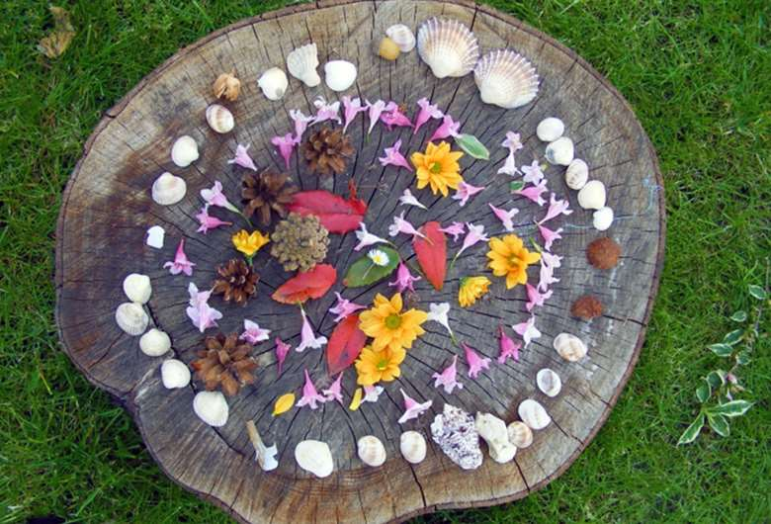
Outdoor Learning
Collect lots of leaves, flowers, sticks, bark, seashells etc.
Create some transient art.
Talk about the objects used. Are they dead or alive?
Think about how the objects will change over time.
Remember the lifecycle – what other animals do we know about that go through big changes in their lifespan?

Slide 27
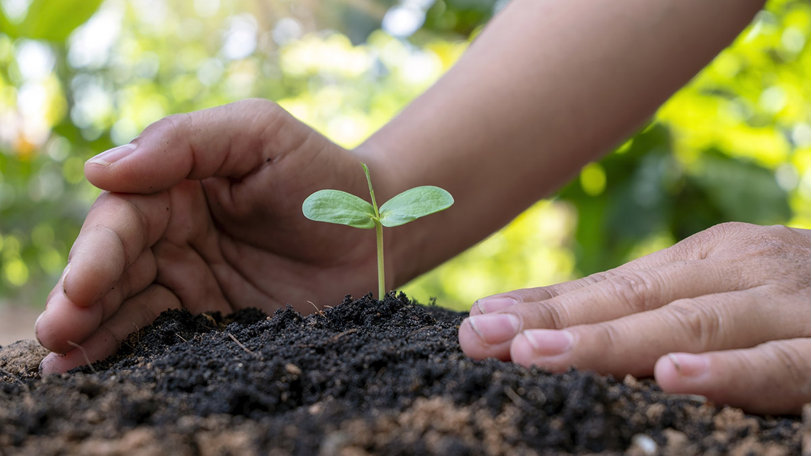
Feeling Happy
When you feel sad, try to do something that makes you happy.
What do you already do?
What new things could you try?
If you feel sad, you could cuddle a pet!
Notes:
Happy Dance
https://www.youtube.com/watch?v=jjkYHr94wnc
Cosmic Kids
https://www.youtube.com/watch?v=A84PKy91LgQ
Guided Imagery
https://www.youtube.com/watch?v=fTzXFPh6CPI

