Slide 1

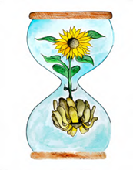

Learning about Bereavement, Loss and Grief
Lesson resource for P3
Learn
East Renfrewshire Bereavement, Loss and Grief Team
With thanks to Winston’s Wish

Slide 2

Today’s lesson
Today we will be thinking about loss and what death means.
Some of us may have already experienced death and know what this feels like.

Slide 3
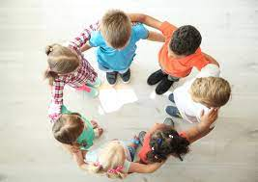
How can we help everyone to feel safe and valued in this lesson?

Slide 4
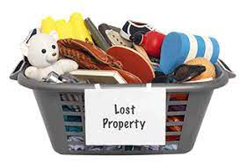
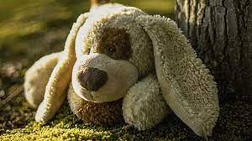
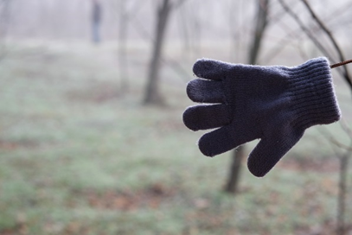
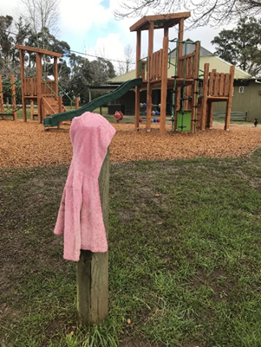
Loss
Can you think of things you have lost?
How did it make you feel?
What did you do?
Did you find it again?
Who helped you?

Slide 5
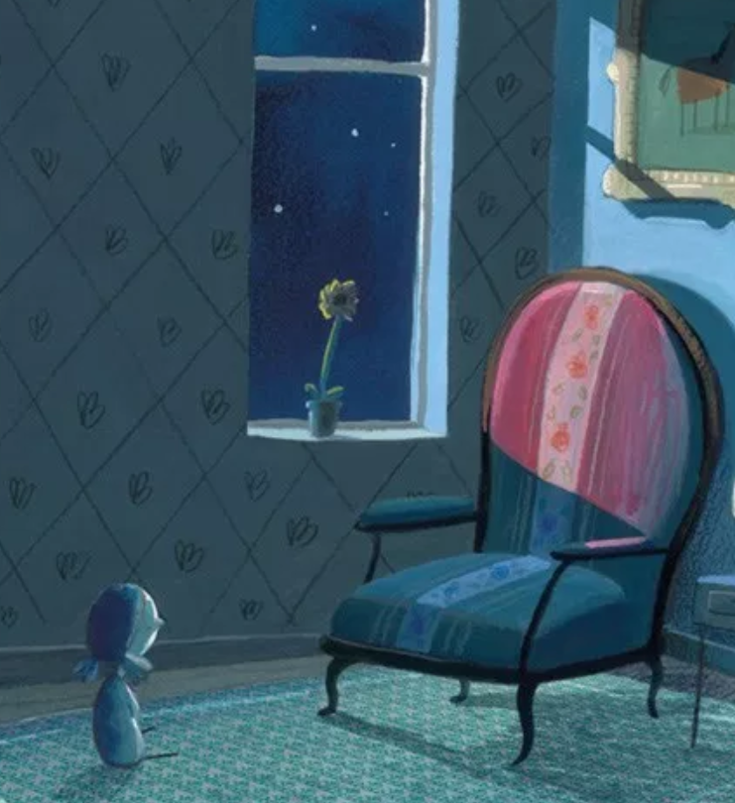
Feelings: loss and grief
Losing a treasured object or useful possession can make you feel annoyed, sad, worried.
Why do you think we might feel sad when we lose something?
This is similar to how we feel when a pet or a person dies but it can feel much more painful.
Grief (or grieving) is the word we use to describe all the feelings we have when someone dies.

Slide 6
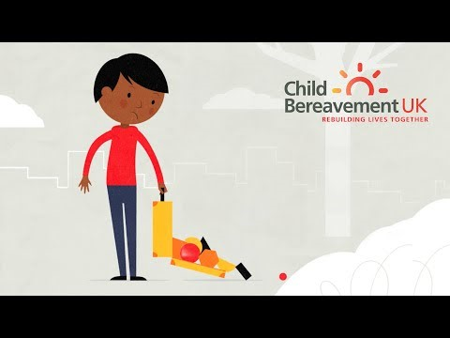
Your Invisible Suitcase
What is inside your invisible suitcase?

Slide 7
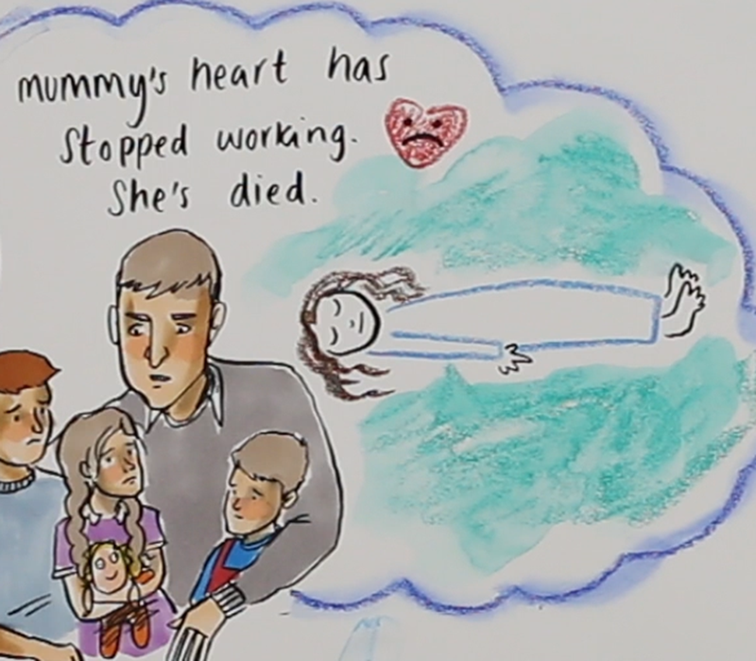
What does ‘dead’ mean?
Being dead means that your body and your head don’t work anymore. Someone who is dead can’t talk, or see, or hear, or eat, or move or feel anything anymore.
Think about stories or movies that involve the death of a character. How do other characters feel when someone else dies?
Notes:
http://www.winstonswish.org/wp-content/uploads/2020/10/WW-PSHE-KS1-L1-A5-Dead-and-alive-cards.pdf

Slide 8
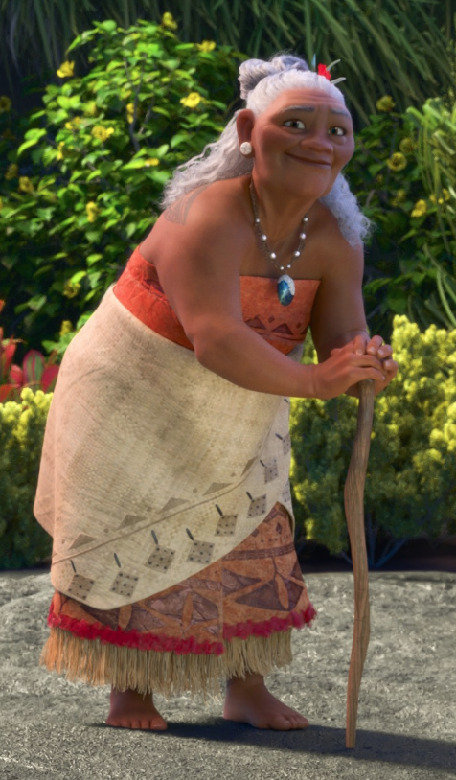
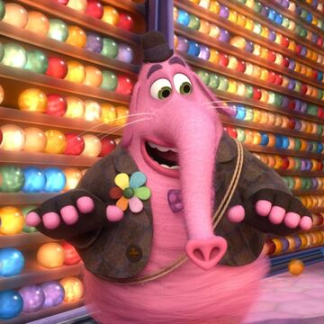
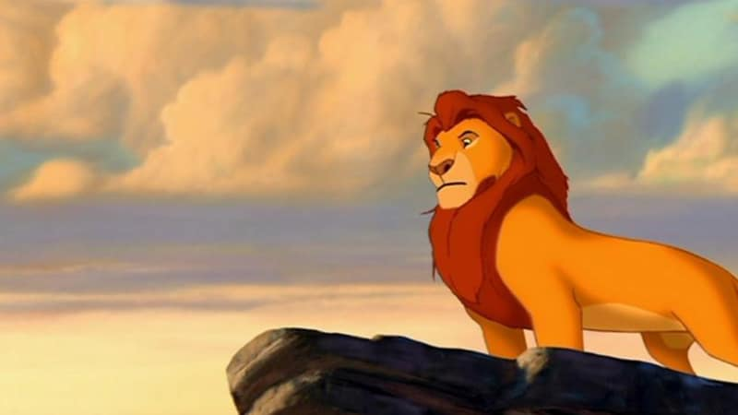
Death in animation
Notes:
Moana’s grandmother dies
Inside Out Bing Bong dies
Lion King Mufasa dies

Slide 9

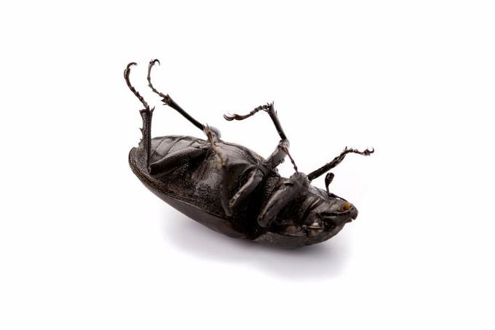
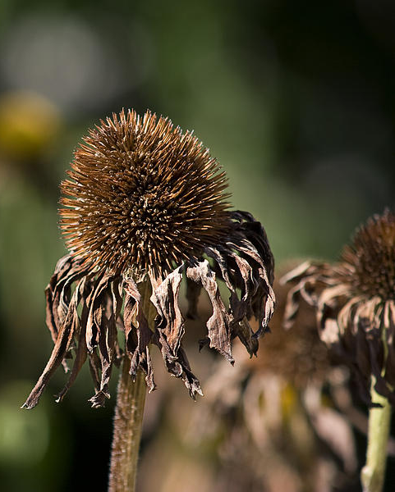
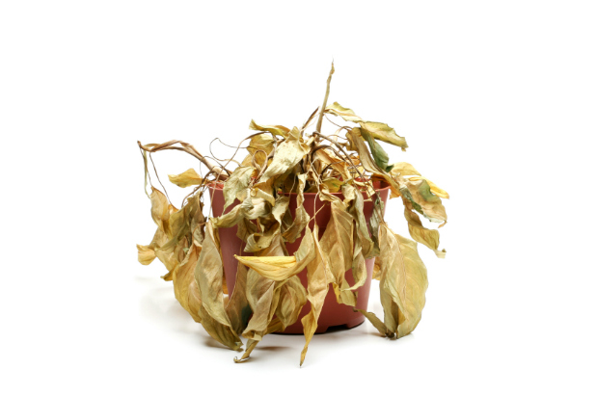
Death
Think of as many words as you can to describe these pictures.

Slide 10
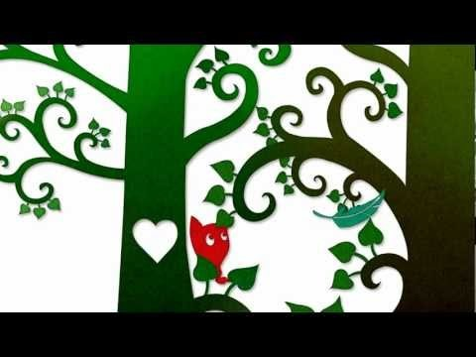
The Small Creature
Think about the journey Small Creature goes on when Bird dies.
Notes:
https://www.youtube.com/watch?v=Ks2DOoZtZ4A

Slide 11

Your Story
Create your own story around the theme of ‘loss’.
Who are your characters?
What happens to them?
What have they lost?
How do they feel?
What helps them?
Notes:
Bottling up your feelings doesn’t help. It’s really important to tell someone how you are feeling.

Slide 12
What did we learn today?
What have you found out about death?
I have found out that death means…
What are the different characteristics of something that is alive, and something that is dead?
The differences are…

Slide 13
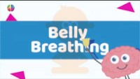
Notes:
https://www.youtube.com/watch?v=RiMb2Bw4Ae8

Slide 14
Learning about Bereavement, Loss and Grief
Lesson resource for P4
Explore
East Renfrewshire Bereavement, Loss and Grief Team
With thanks to Winston’s Wish

Slide 15

Today’s lesson
Today we will be thinking about finding comfort when someone dies.
Some of us may have already experienced a loss in our lives including the death of someone close

Slide 16
Recap - How can we help everyone to feel safe and valued in this lesson?

Slide 17
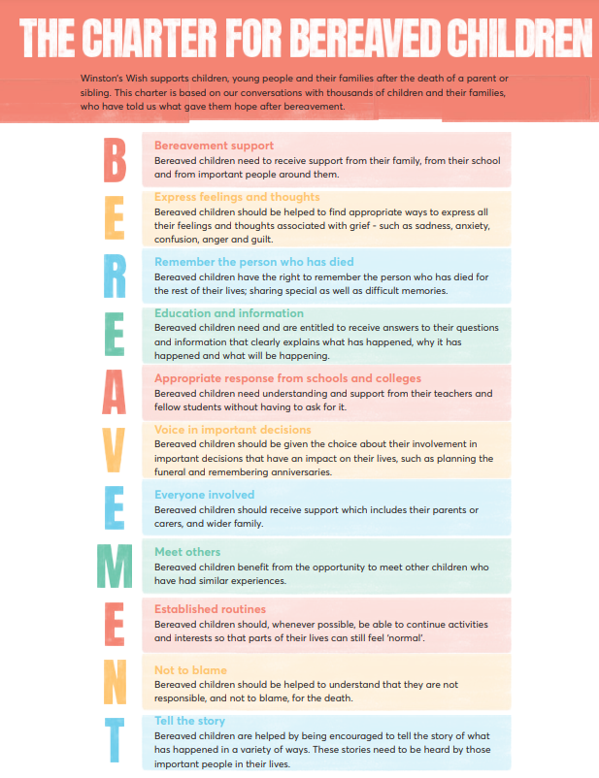

The Bereavement Charter

Slide 18

Recap from session 1 We know that when someone dies this means… This may make us feel…

Slide 19
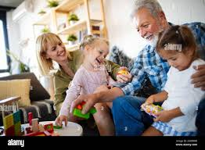
Finding Comfort in Memories
Remembering good times we’ve had with someone can really help us to feel better when they are not with us anymore.
Think about something you have done with someone special to you or a pet. This person could be alive or dead
Make a picture or model of your memory.

Slide 20

Grief is like a maze

Slide 21
What did we learn today?
What have you found out memories?
I have found out that memories..
What have you found out about grief?
Grief is…

Slide 22
Notes:
https://www.youtube.com/watch?v=RiMb2Bw4Ae8

Slide 23
Learning about Bereavement, Loss and Grief
Lesson resource for P3
Grow
East Renfrewshire Bereavement, Loss and Grief Team
With thanks to Winston’s Wish

Slide 24
Today’s lesson
Today we will be thinking about what death means
Some of us may have already experienced death and know what this feels like.

Slide 25
Recap - How can we help everyone to feel safe and valued in this lesson?

Slide 26
The Bereavement Charter
Remind yourself of the bereavement charter and your own class charter for loss, grief and bereavement.

Slide 27
Recap from session 1 and 2 We know that when someone dies this means… This may make us feel… What is grief? How can we find comfort?

Slide 28
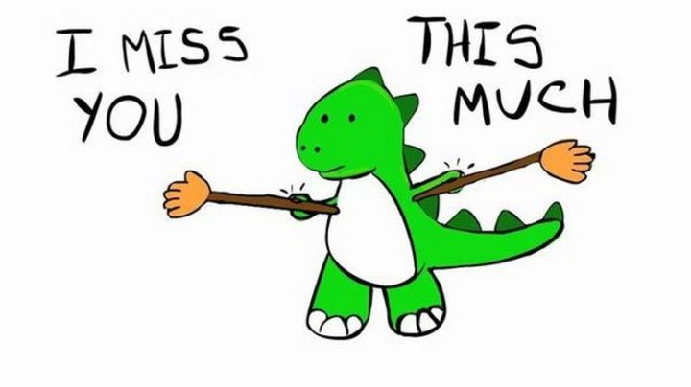
I Miss You!
Think about people, animals, places or things you miss. Share these with the class.

Slide 29
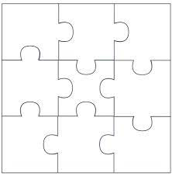
The Puzzle of You
There are lots of things that make you special
These things fit together like a jigsaw to make you the person you are
It’s important to celebrate everything that makes you a special and unique person
What would go in your jigsaw?
Kind
Good at gymnastics
Like to bake cupcakes
Helps granny with chores
Good at writing stories
My friends
People I miss

Slide 30
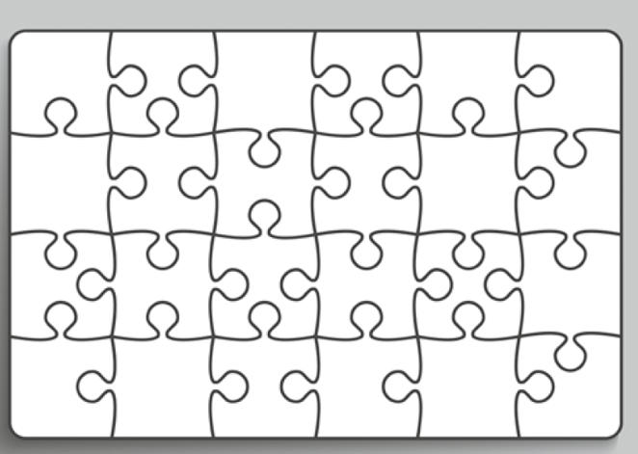
The Puzzle of You
Create a jigsaw puzzle to celebrate YOU! You may include losses, achievements, friendships, likes/dislikes, good times and difficult times.

Slide 31
Notes:
https://www.youtube.com/watch?v=RiMb2Bw4Ae8

